Slide 1
COBOT ARM GRIPPEr prepared by- saragraj konwar sulakshana chetry mridupaban gayan ayan mandal nayan pegu krishna damai

Slide 2
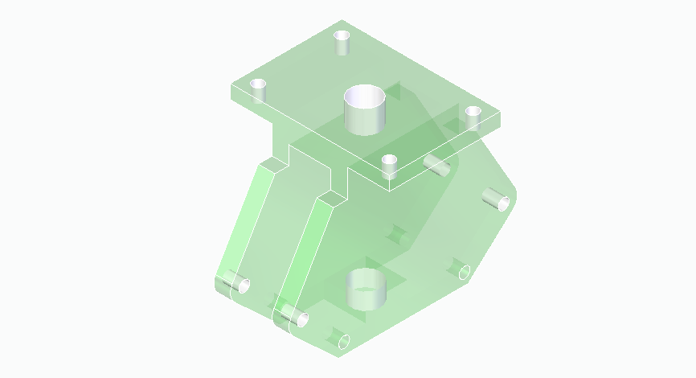
Frame of the Gripper

Slide 3
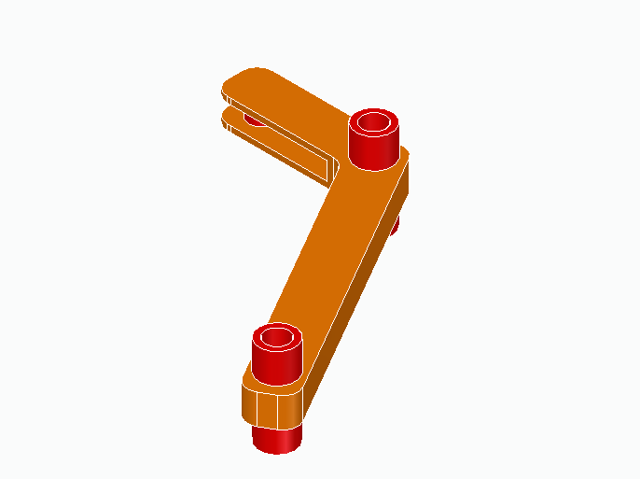
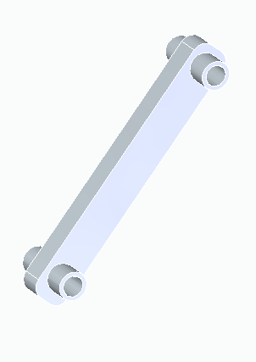
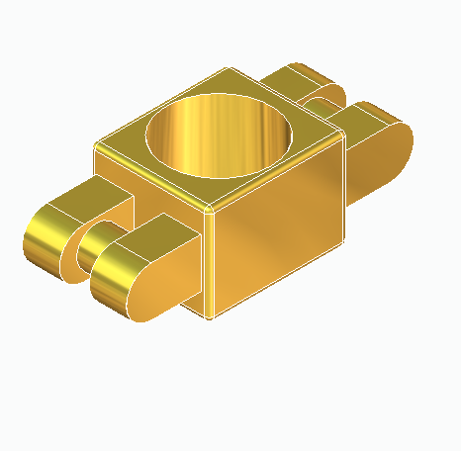
Link

Slide 4
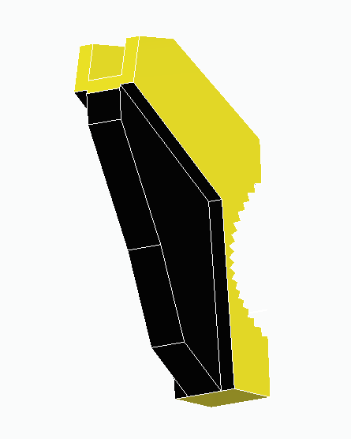
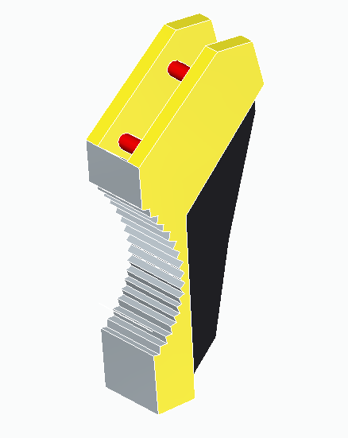
Gripper Jaw

Slide 5
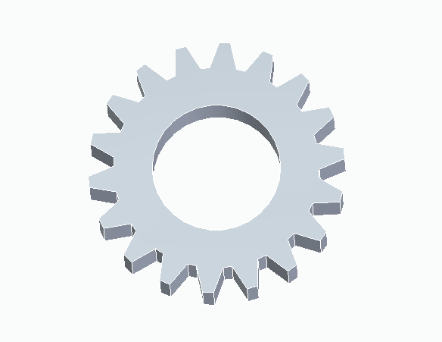
Gear

Slide 6
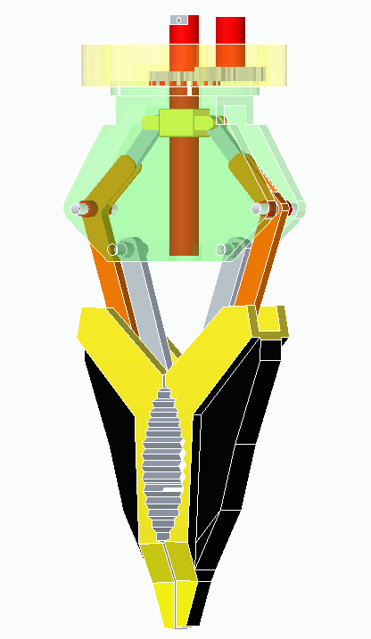
Assembled gripper of COBOT

Slide 7
Working
Pneumatic motor is used for opening and closing of gripper. In extension opening of the gripper jaw and in retraction closing of the gripper jaw takes place. The gripper will be used to grip the terminal box, to place the wires and to hold the nuts.
Servo motor is used to rotate the whole gripper with the help of gears for tightening and loosening the nuts.
The function of links is to manipulate the mechanism of the gripper.
The frame supports the components of the gripper.
The function of gripper jaw is to hold ,pick up and place the objects in right positions .

Slide 8
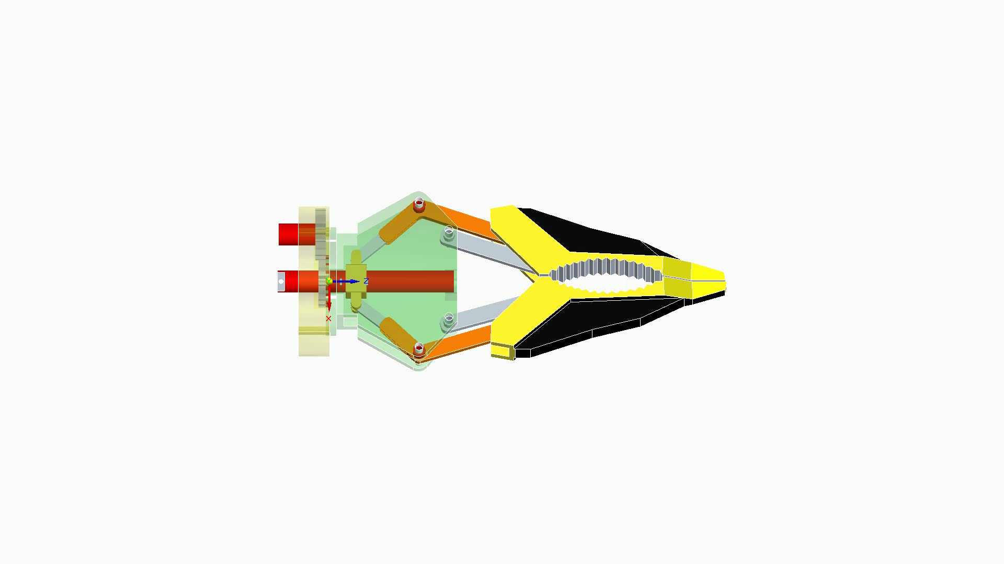
Simulation

Slide 9
THANK YOU

